Slide 1
Hosting a static website using AWS-S3
NAME:Khasab ArshadBasha

Slide 2
Introduction
1.what is Static Website Hosting?
A static website delivers content that doesn't change for each user.HTML, CSS, JS files served directly to users.Why use AWS S3?Scalable, reliable, cost-effectiveNo need for servers
2. What is Amazon S3?
Amazon S3 (Simple Storage Service):Object storage serviceStores files like HTML, CSS, JSHighly durab'd accessible.
3. What is Amazon s3?
Amazon s3(simple storage service):
Object storage service
Stores files like HTML,CSS,JS
Highly durable and accessible

Slide 3
Step 1: Login to AWS ConsoleGo to: https://console.aws.amazon.comSign in with your AWS credentials.
Step 2: Create a New S3 BucketNavigate to S3 ServiceClick “Create bucket”Enter a unique bucket name (example: my-static-site-bucket)Select a regionUncheck: "Block all public access" (to allow public website access)Click “Create bucket”
Step 3: Upload Website FilesOpen the created bucketClick “Upload”Add your files (index.html, style.css, etc.)Click “Upload” again
Step 4: Enable Static Website HostingGo to the Properties tab of the bucketScroll to Static website hostingClick Edit → Enable itSet:Index document: index.htmlError document: error.html (optional)Save changes
Step 5: Make the Bucket PublicGo to the Permissions tabUnder Bucket Policy, paste the below JSON:{ "Version": "2012-10-17", "Statement": [{ "Sid": "PublicReadGetObject", "Effect": "Allow", "Principal": "*", "Action": "s3:GetObject", "Resource": "arn:aws:s3:::your-bucket-name/*" }]}Replace your-bucket-name with your actual bucket nameClick Save
Step 6: Access Your WebsiteGo to the Properties tab againScroll to Static website hostingCopy the website endpoint URLOpen it in your browser — your site is now live!

Slide 4
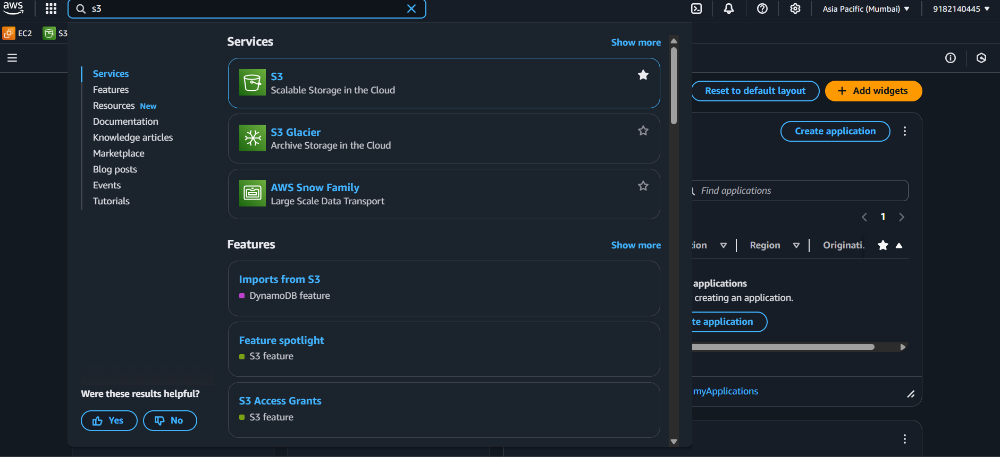
Create the s3 Bucket

Slide 5
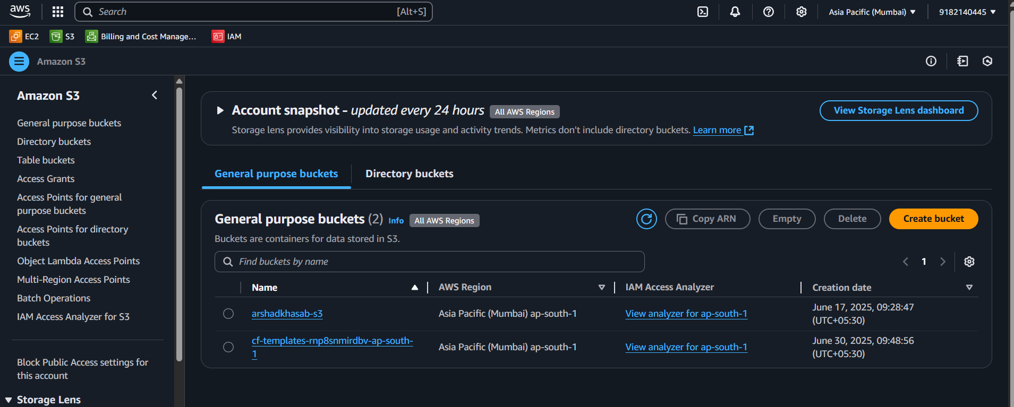

Slide 6
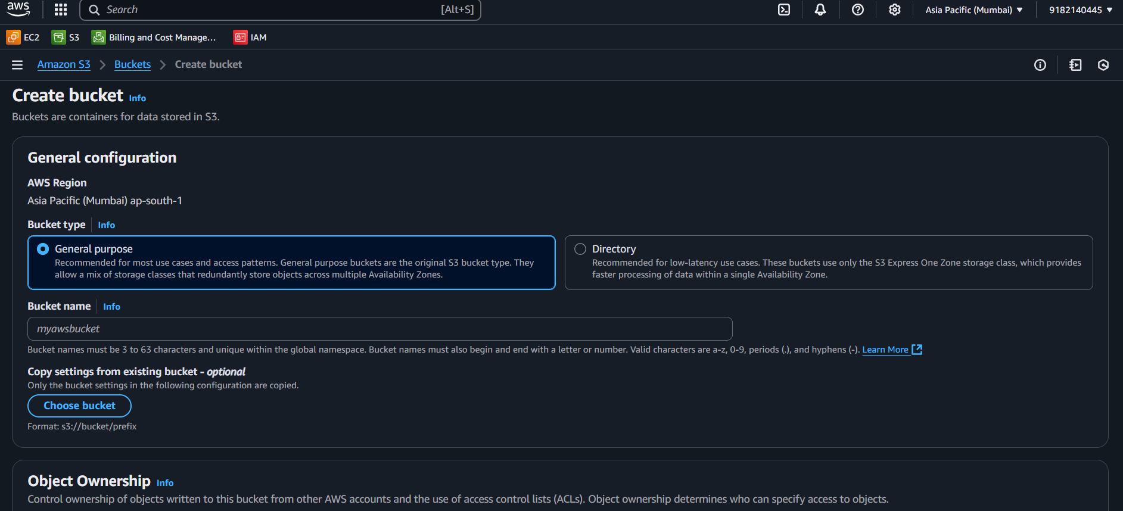
Give a unique name for the bucket

Slide 7
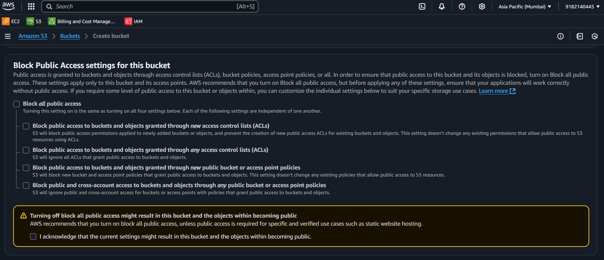

Slide 8
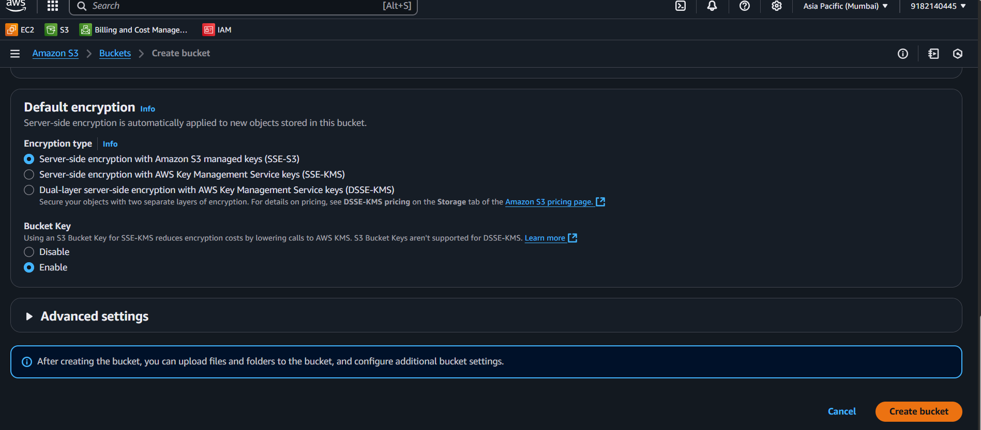

Slide 9
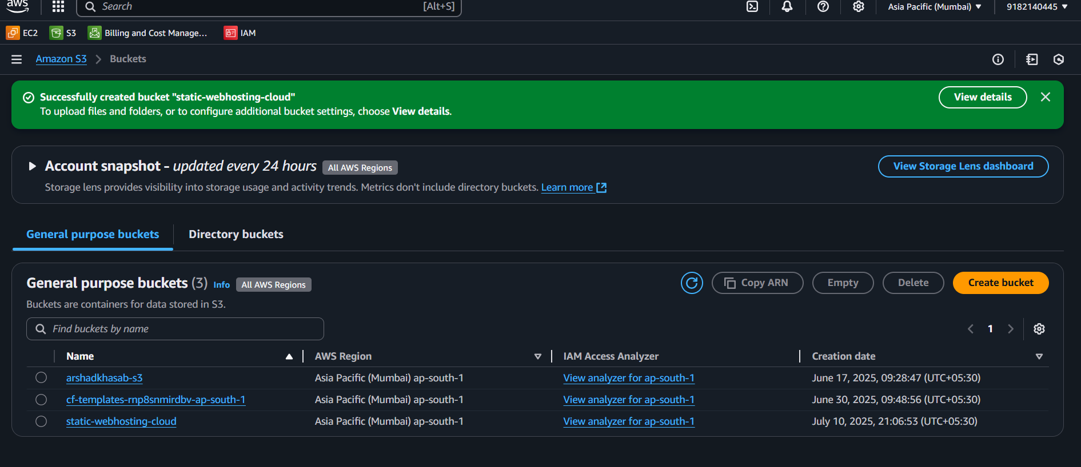
Bucket is created

Slide 10
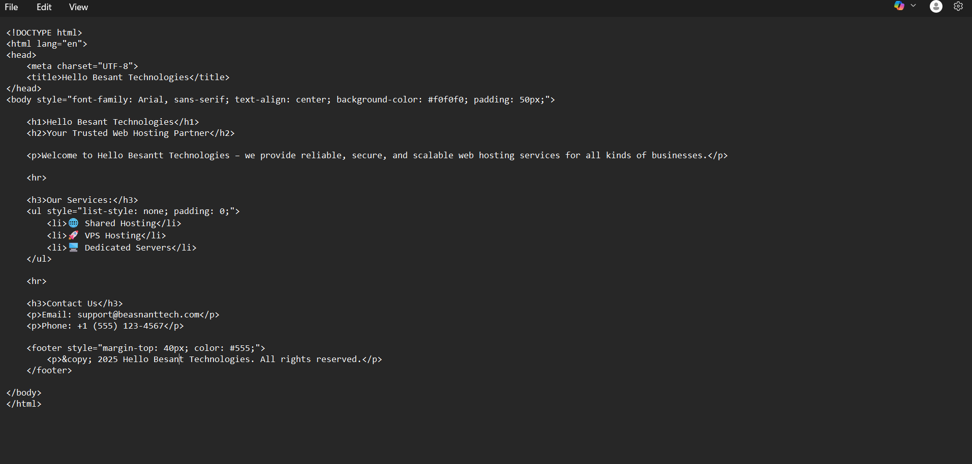

Slide 11
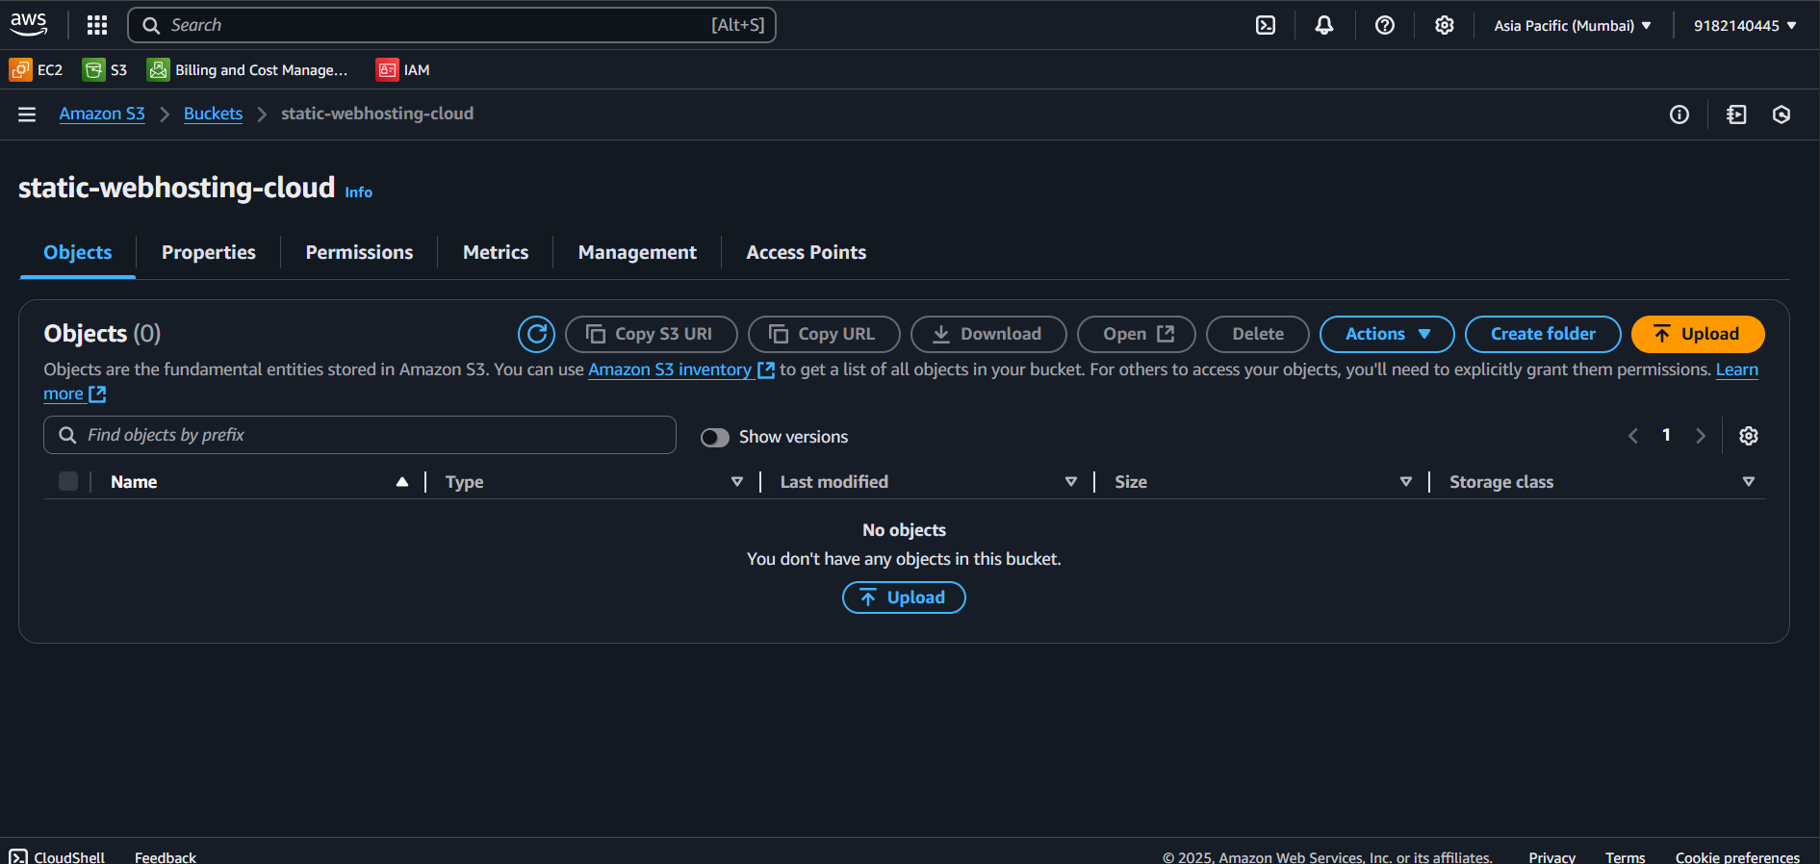
Upload the Index.html file to the bucket

Slide 12
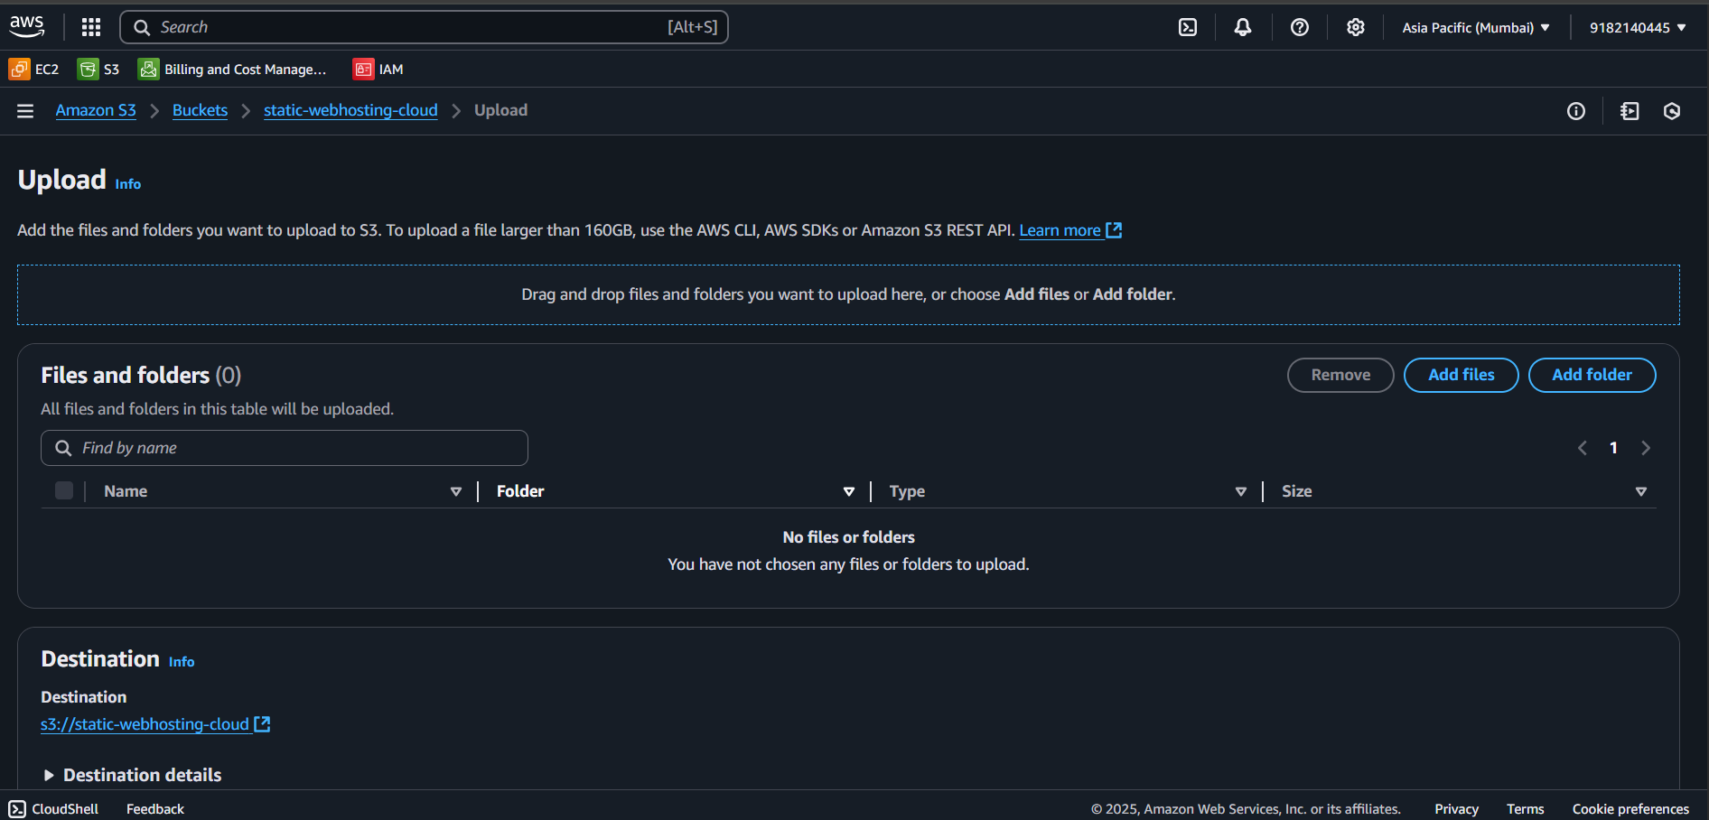

Slide 13
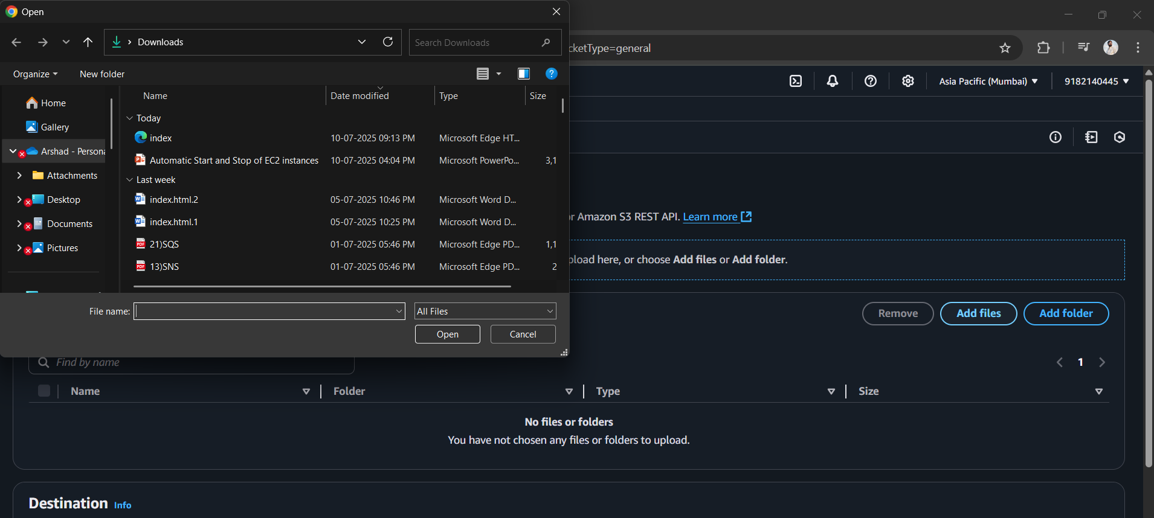

Slide 14
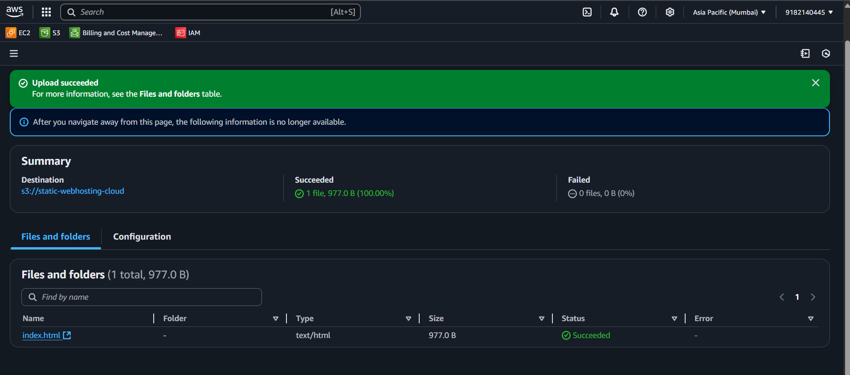

Slide 15
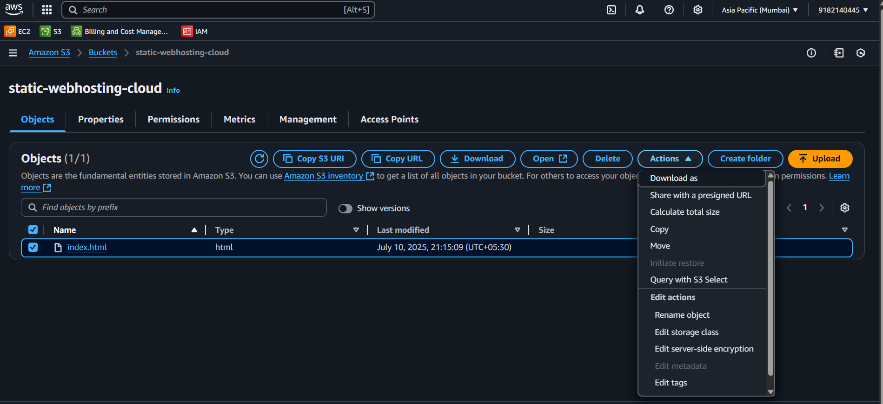

Slide 16
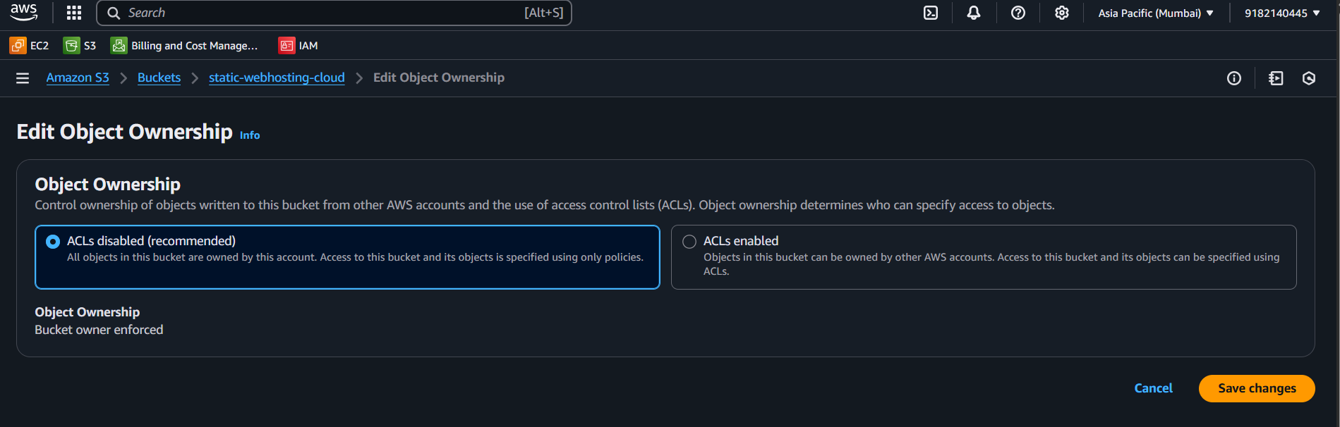

Slide 17
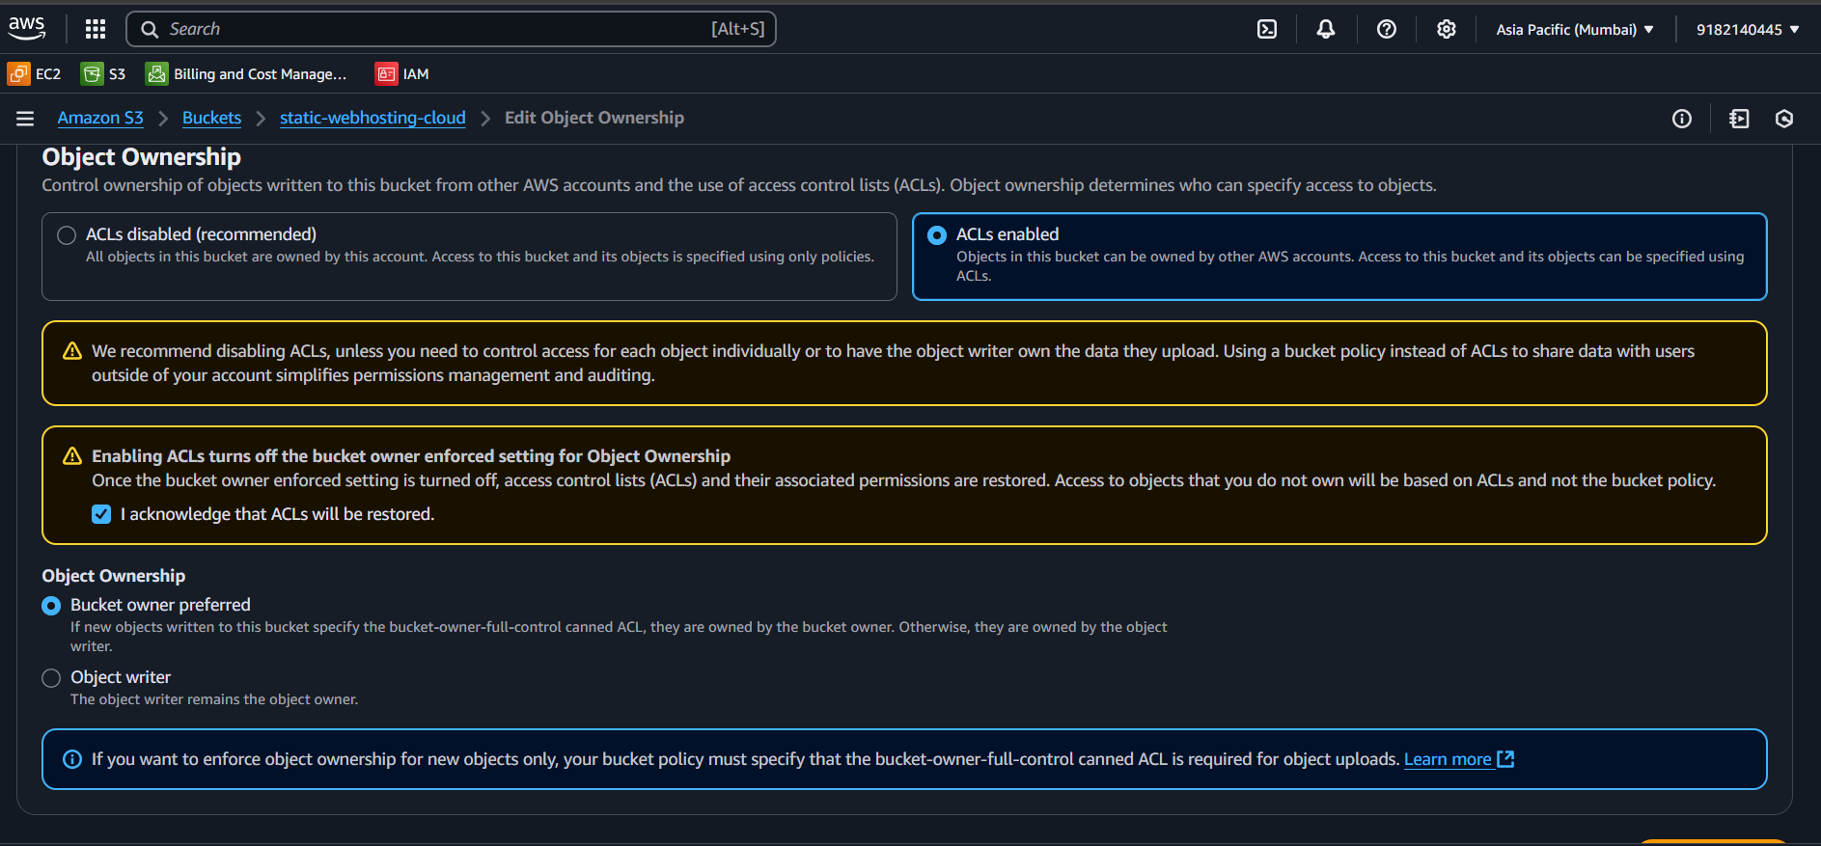

Slide 18
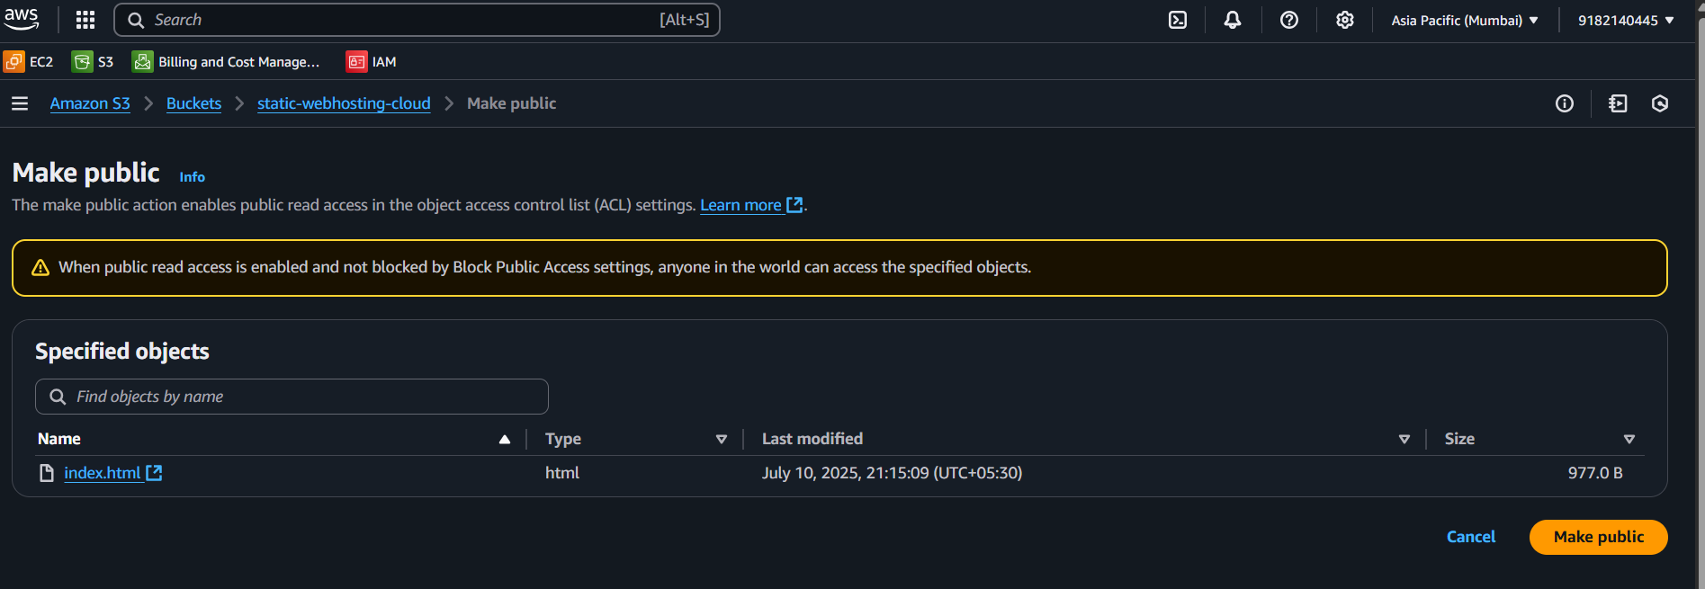

Slide 19
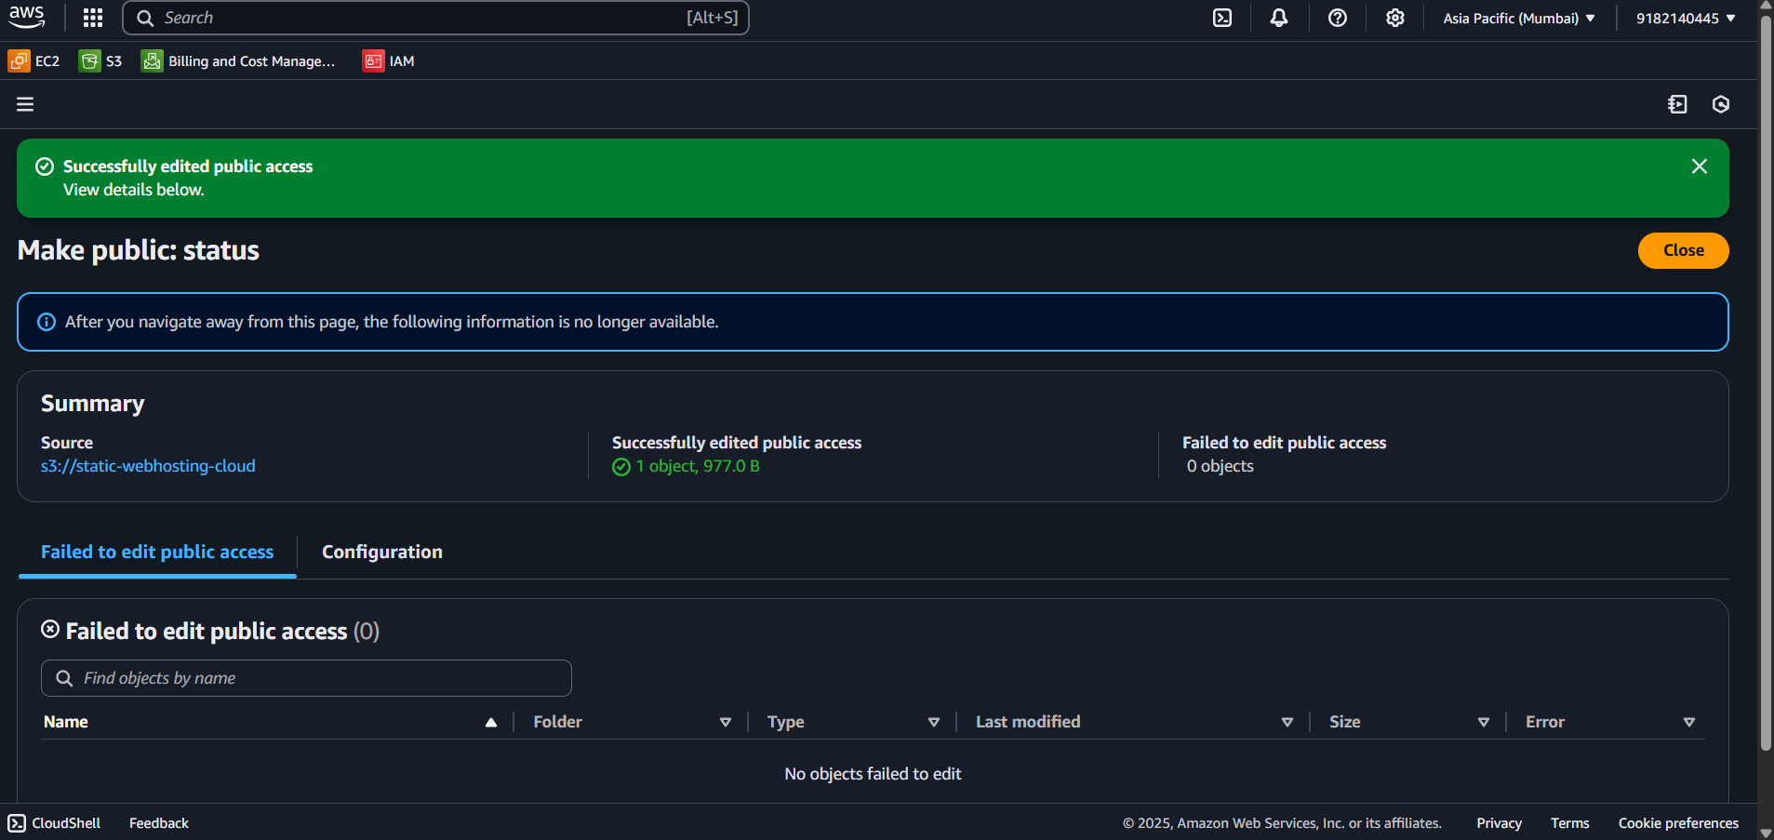

Slide 20
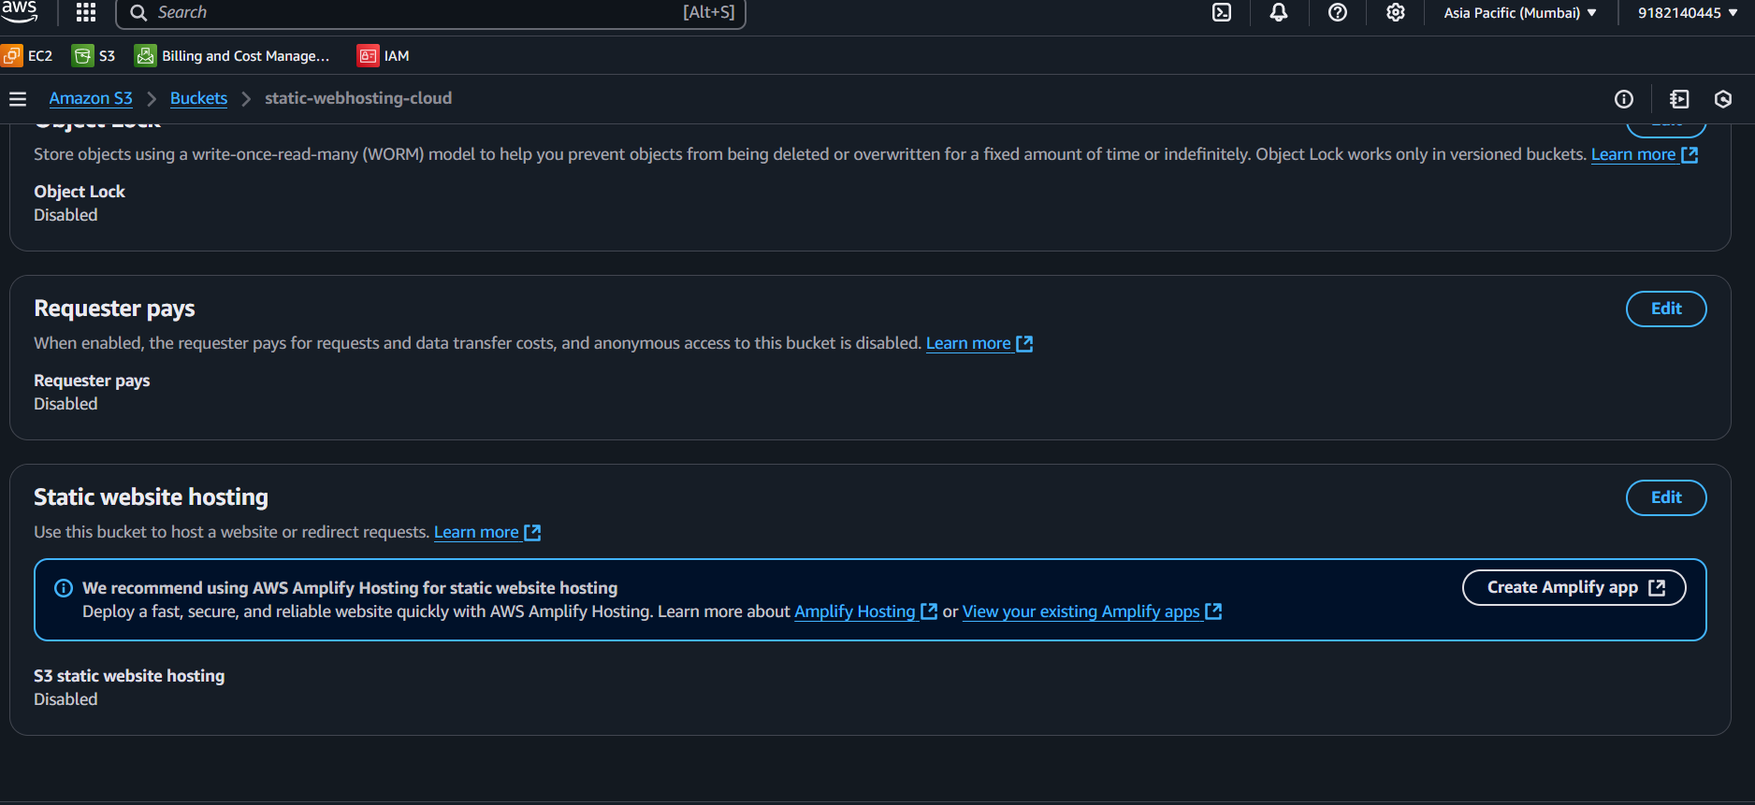

Slide 21
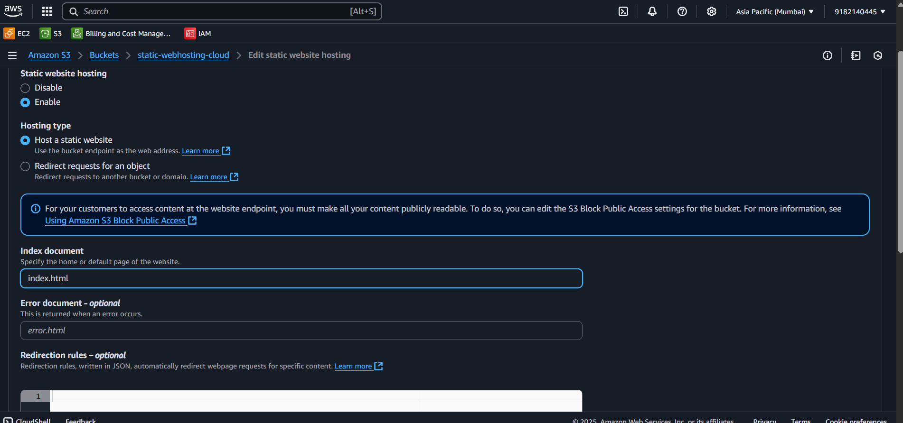

Slide 22
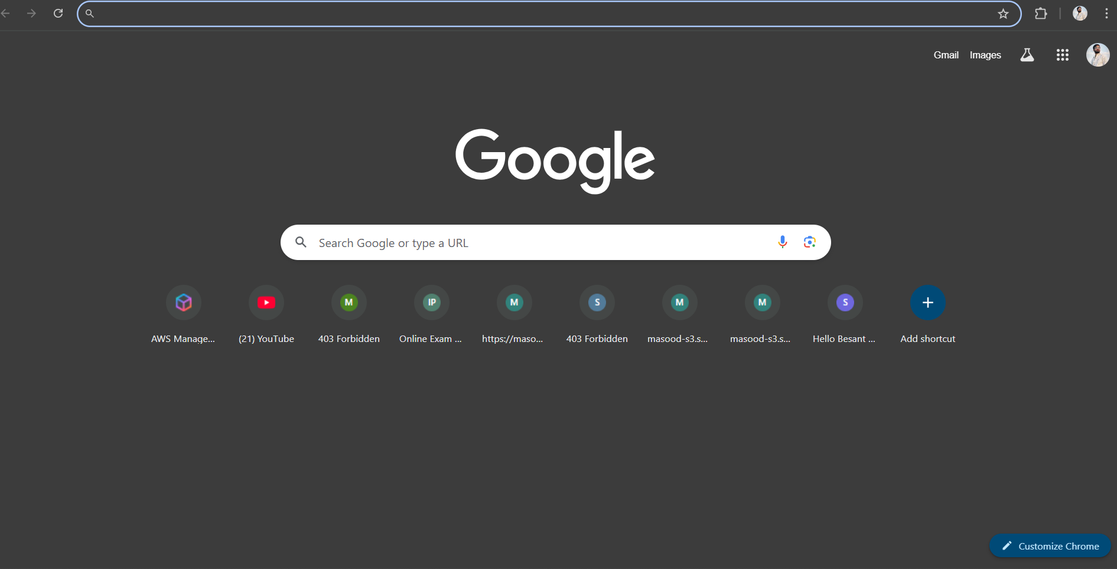

Slide 23
